Slide 1

Ultrasonic ranging with ESP32
IoT Project Presentation
SENTHILNAATHAN K - 210701238
SHAMINI P N - 210701239

Slide 2
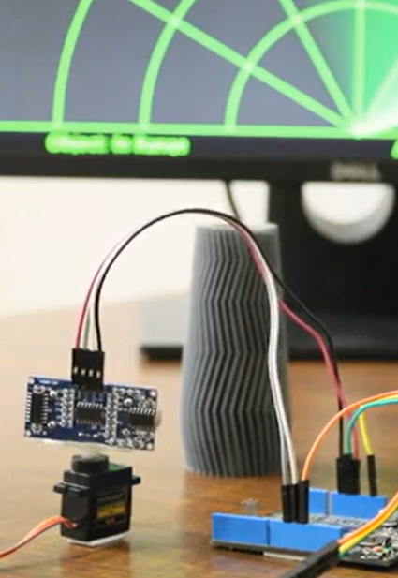
Agenda
Introduction
Purpose of Project
Components used
Circuit diagram
Conclusion and future enhancements

Slide 3
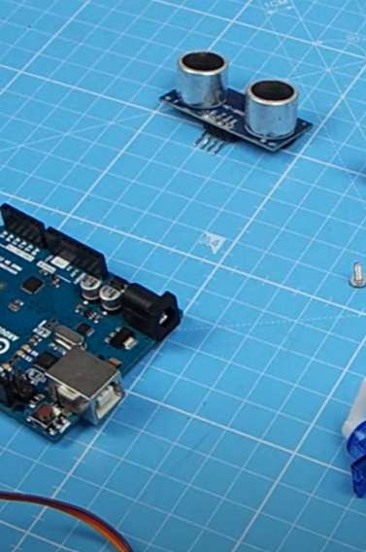
Introduction
This project delves into the construction of an DIY ultrasonic ranging system, also known as a radar.
This system utilizes an ESP32 microcontroller, a servo motor, and the Blynk application for data visualization.
The measured parameters are plotted as a radar form in PROCESSING IDE and visualized in Blynk app

Slide 4
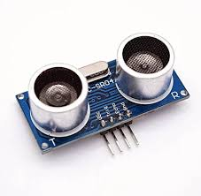
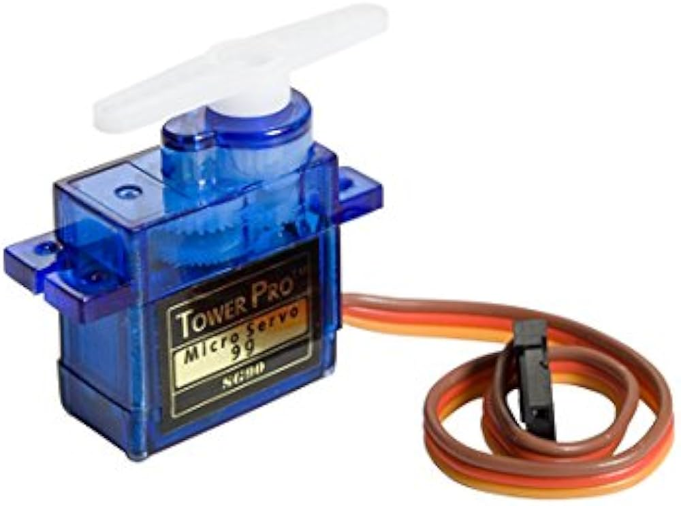
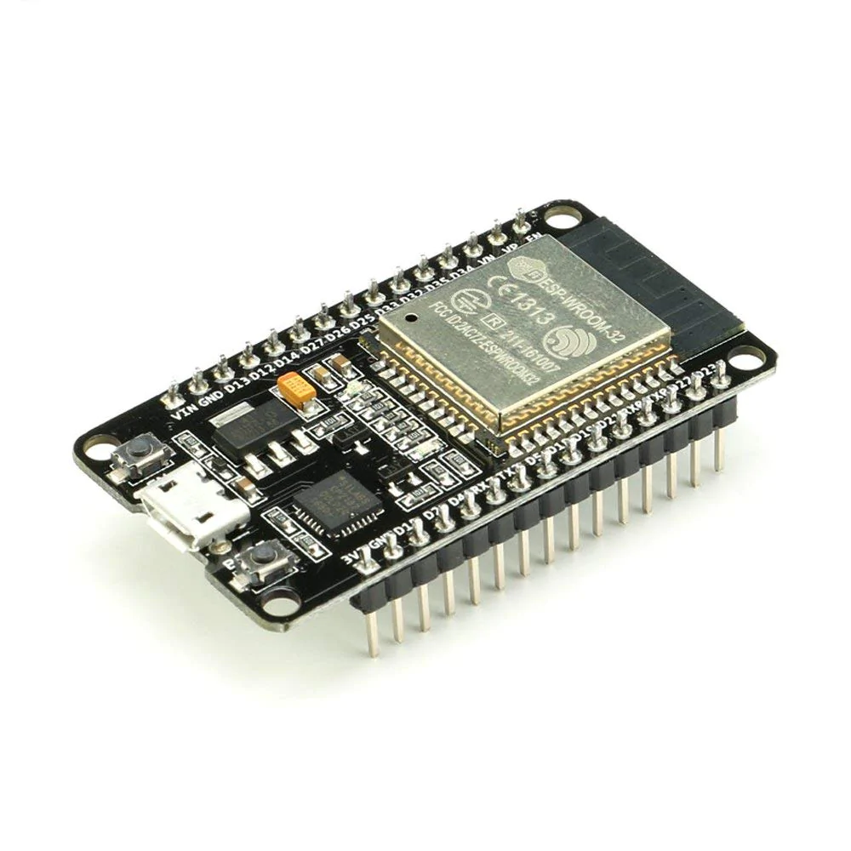







Components
ULTRASONIC
SENSOR
SERVO MOTOR
ESP32
Arduino IDE
Processing IDE
Blynk app

Slide 5

Purpose
The primary objective of this project is to build a practical ranging system using readily available components.
Through its construction, we gain valuable insights into the functionalities of:
Ultrasonic sensors for distance measurement
ESP32 microcontrollers for data processing and communication
Servo motors for controlled movement of the ultrasonic sensor
Visualizing the results using PROCESSING IDE

Slide 6
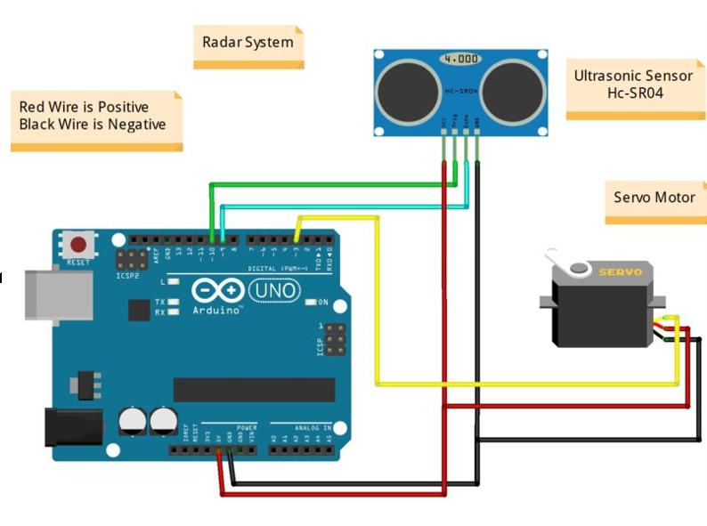
CIRCUIT DIAGRAM

Slide 7

Results
A simple radar system using Ultrasonic sensor is developed
Studied integration of various IoT Components in real time
Serial communication with COM 8 on Processing IDE is achieved
Device control and Data visualization using Blynk.

Slide 8
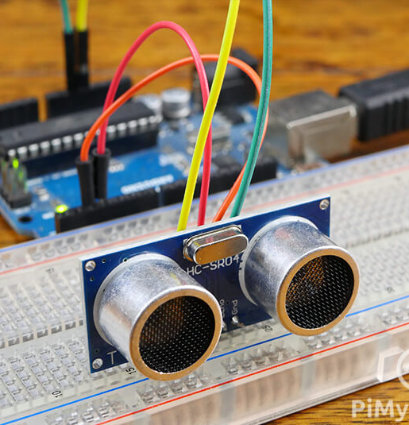
Conclusion
In conclusion, this project successfully demonstrates the construction of a functional ultrasonic ranging system. We have gained valuable practical experience working with ultrasonic sensors, ESP32 development, servo motor control, and data visualization using the Blynk app.
Future enhancements :
Additional sensors to improve accuracy and coverage, such as infrared or LIDAR sensors.
Implementing machine learning algorithms for object recognition and classification could further enhance the system's capabilities.

Slide 9
Thank you

